Slide 1
A Short Intro to Pointers

Slide 2
Pointer Variables
Pointer variable: Holds an address of a memory location. Often just called a pointer
32-bit system: pointers are 4 bytes
64-bit system: pointers are 8 bytes
A pointer points to another memory location

Slide 3
Defining a Pointer
Definition of a pointer has two parts: the pointer itself and the type of data that the pointer points to.
Example
int * pVar;
int is the data type pointed to by pVar
* declare pVar as a pointer
The pointer above points to a random memory location. This is dangerous. Instead
int * pVar = nullptr;

Slide 4
Pointing to a memory location
To point to a specific memory location, the memory location is assigned to the pointer using the address of (&) operator
Example
int num = 5;
int * pNum = &num;
Pointers can only point to variables of their same data type

Slide 5
Dereferencing a Pointer
To access the value of the memory location that a pointer points to, we use a dereference operation
Example
char grade;
char * pGrade = &grade;
*pGrade = ‘A’; // grade is now ‘A’
cout << *pGrade; // ‘A’ is displayed on the monitor

Slide 6
Why pointers need data types
From the dereferencing example, we can observe why we need a data type for the pointer.
The pointer itself is always 4 (or 8) bytes regardless of what it points to.
In order to properly write a value to or read a value from a memory location we need to know the data type so that we know how many bytes to read (or write).
Look at some examples

Slide 7
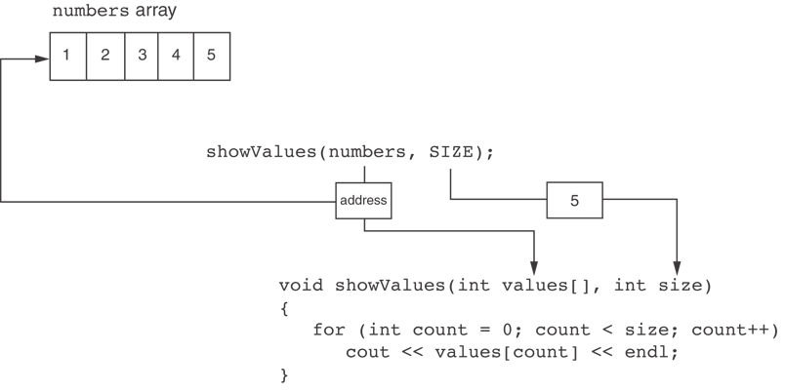
Something Like Pointers : Arrays
The values parameter, in the showValues function, points to the numbers array.
C++ automatically stores the address of numbers in the values parameter.

Slide 8
Pointers and the new operator
Create a pointer to a memory location without having a name to the memory location
new allocates memory at runtime
Example
int * pVar = 0; // create a pointer to int and assign 0
pVar = new int; // allocate 4 bytes of memory and assign
// address to pVar
*pVar = 5; // memory location contains 5
cout << *pVar; // 5 is wrote to monitor
Dynamically allocated memory is called heap memory. Compile time memory is called stack memory.

Slide 9
Dynamic arrays
Using dynamically allocated memory we can wait until runtime to assign the size of an array
Example
double * grades;
int numGrades = 0;
cout << “How many grades should we process? “;
cin >> numGrades;
grades = new double[numGrades];
for( int i = 0; i < numGrades; i++ )
{
cout << “Enter grade “ << i + 1 << “: “;
cin >> grades[i];
}

Slide 10
Dynamic Arrays
Notice we did not need the dereference operator in the last example
Using the dereference operator with pointer arithmetic, we can rewrite the above for loop as
for( int i = 0; i < numGrades; i++ )
{
cout << “Enter grade “ << i + 1 << “: “;
cin >> *(grades + i)
}

Slide 11
The delete operator
Anytime memory is allocated using new it needs to be deallocated using delete before the pointer goes out of scope
Failure to do this will cause a memory leak
Example
int * pNum = new int;
char * pLetterGrades = new char[numGrades];
// use these pointers for brilliant processing
delete [] pLetterGrades;
delete pNum;
pLetterGrades = 0;
pNum = 0;

